Slide 1
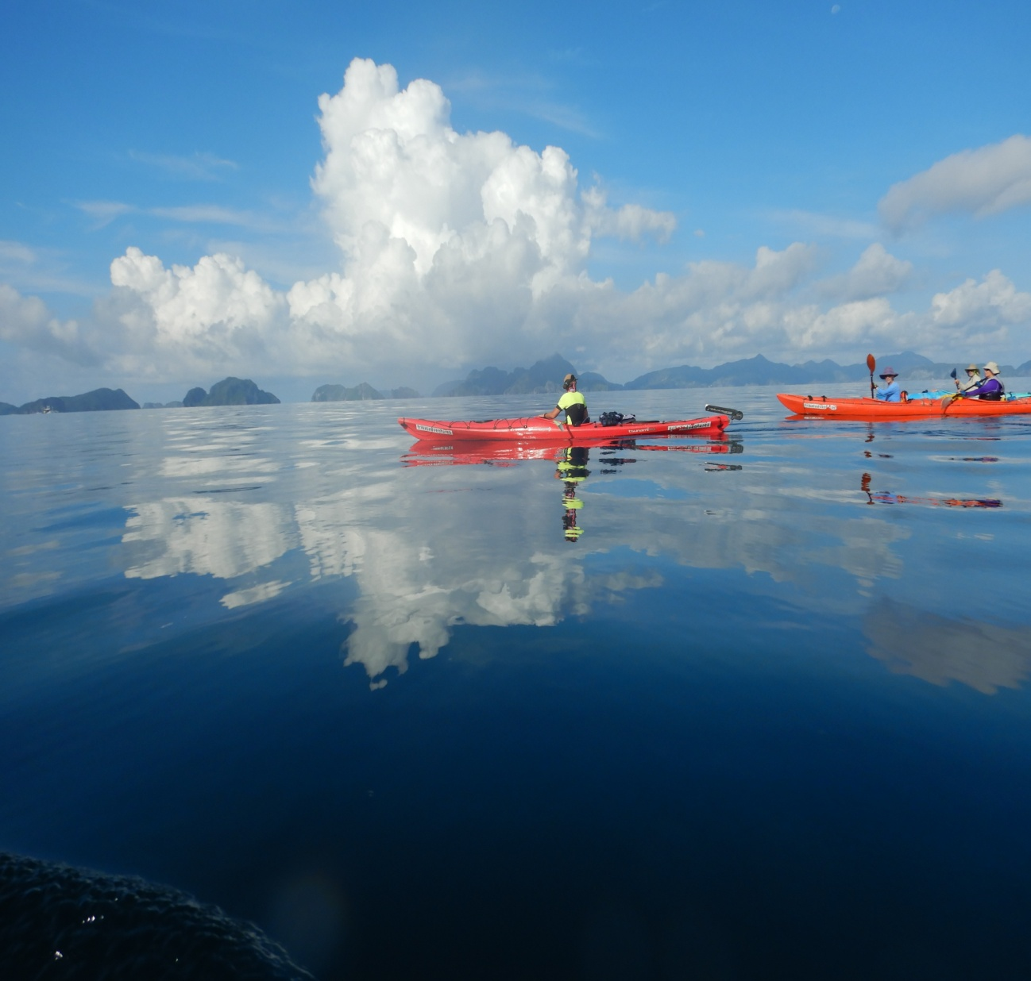
Greg Hutchinson_Task5_Presentation

Slide 2

Greg Hutchinson_task 5
Presentation
Remote Coron Kayak
From time-tunnels to secret lagoon: Explore the spectacular indigenous heartland of Coron on a guided paddle that leaves kayakers speechless – literally!
Notes:
++ In an effort to emerge stronger on the other side of Covid, Tribal Adventures is expanding its adventure tourism offerings with a special take on exploring Coron Island’s dramatic east coast that draws on the founder’s interest in, and advocacy for, indigenous rights. The Remote Coron Kayak is a guided paddle through a spectacular limestone seascape featuring what must be some of the longest stretches of undercut cliffs in the world and into a lagoon so special to the indigenous people of Coron that it has its own language

Slide 3
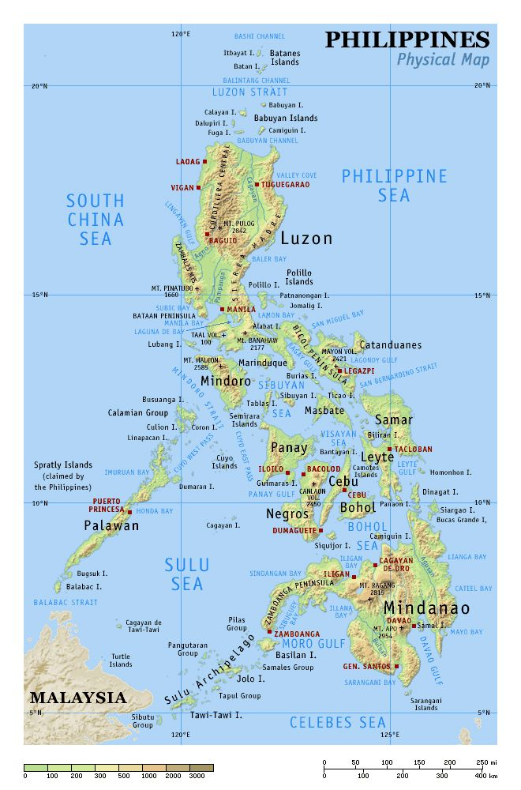
The Philippines is the world’s second largest island nation and Coron one of the top spots to paddle
Notes:
++ Coron is one of more than 7,000 islands in the Philippines, the next largest island nation after Indonesia.
ICON: Coron is in the west of the archipelago, part of Palawan province—an island group recognised in recent years by magazines Travel and Leisure and Conde Naste Traveler as the best island group in the world.
(((circle the island)))
Tourism accolades aside, Coron stands out for it’s dramatic limestone landscape, coupled with its indigenous culture and the compelling perspectives of the physical that throws up

Slide 4
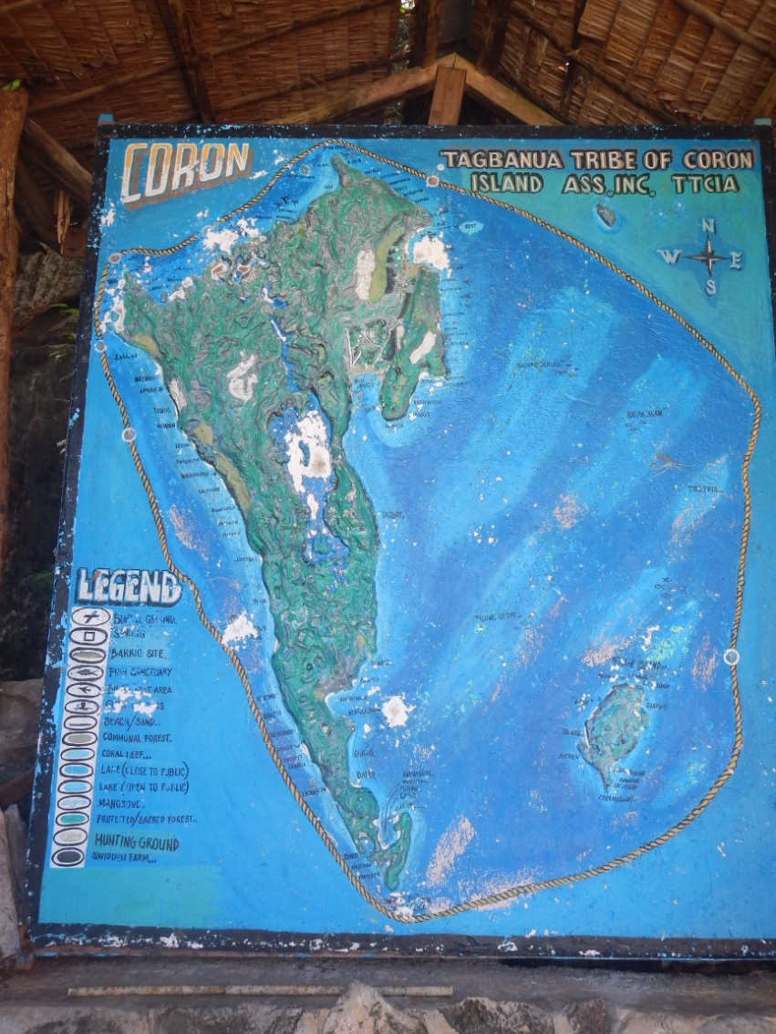
Native title to the land & sea enriches the story of Coron and perfects the paddling experience
Notes:
+++ Perspectives that have gained currency with native title being granted nearly two decades ago, not just the land, but critically the sea.
ICON: The sea area is much bigger than the land area. That’s key. The sea’s the lifeline for the seafaring indigenous people of Coron, the Tagbanua: Fishing occupies them most and the sea in Coron’s east is home to their spiritual being, the Giant Octopus
(((draw Giant Octopus)))
ICON: The Remote Coron Kayak is a paddle of the southern third of coastal Coron. The east, the cultural heartland, is invariably inaccessible November to March as it is battered by a strong easterly, called the amihan, in those months.
(((draw amihan wind arrows indicating direction from eastnortheast)))

Slide 5
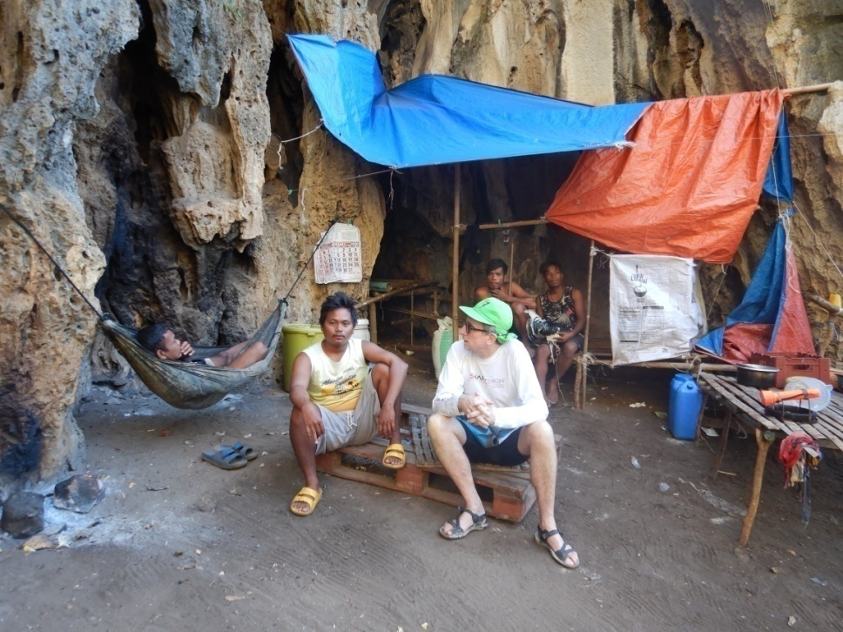
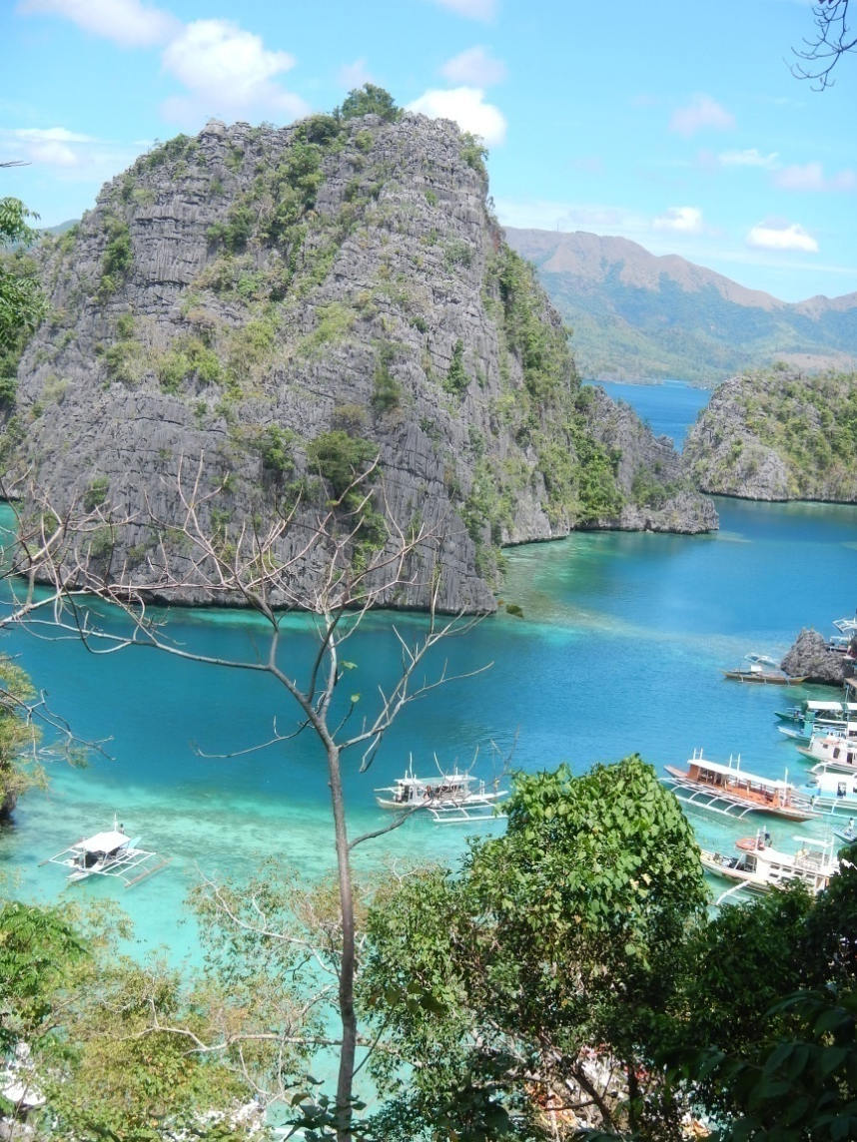
Preservation of environment and culture is at the core of the Remote Coron Kayak
Notes:
++ And at the core of the Remote Coron Kayak is protecting Coron’s environment, which is inextricably linked to preserving Tagbanua culture

Slide 6
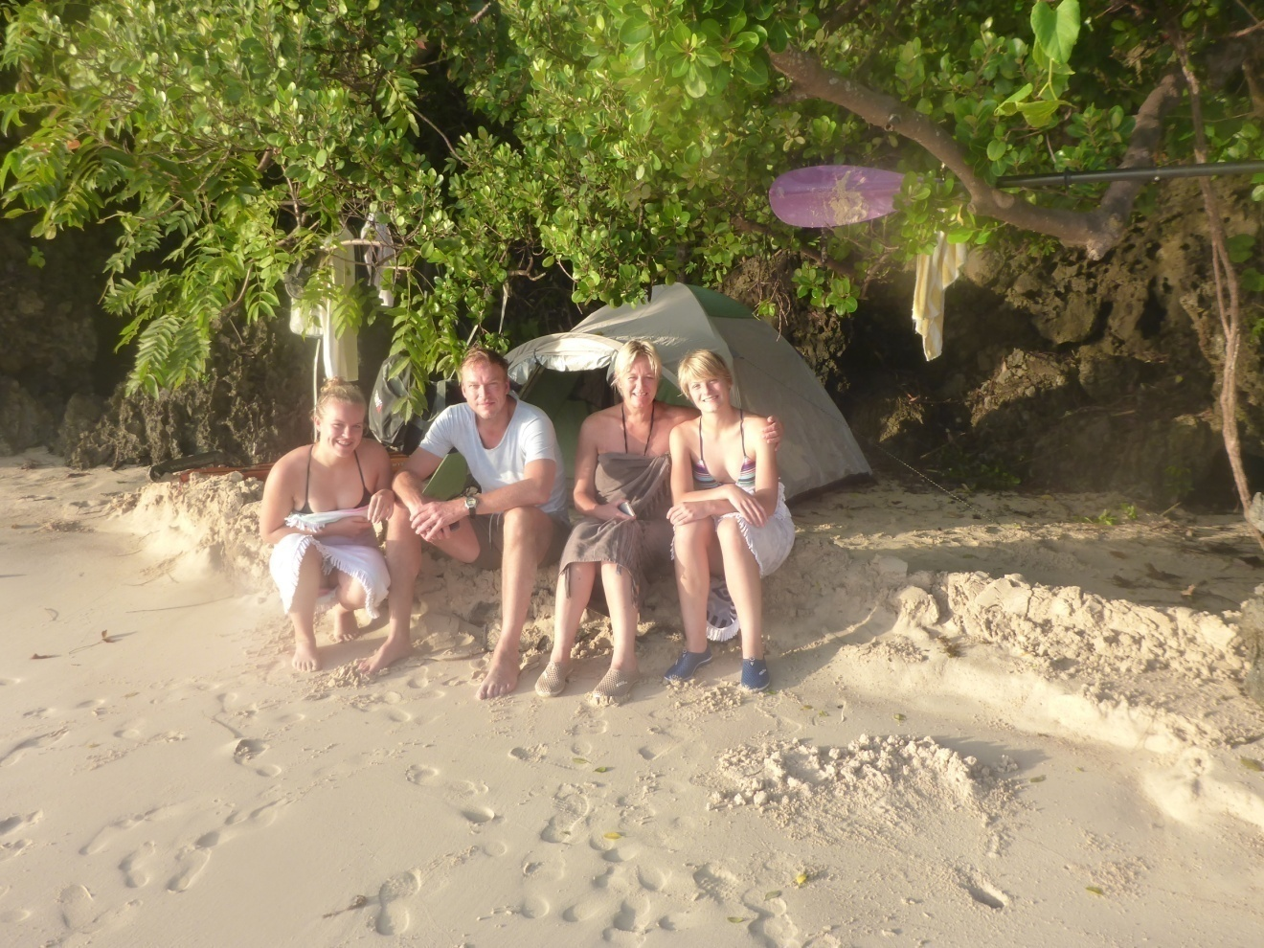
Families are a favoured audience

Slide 7
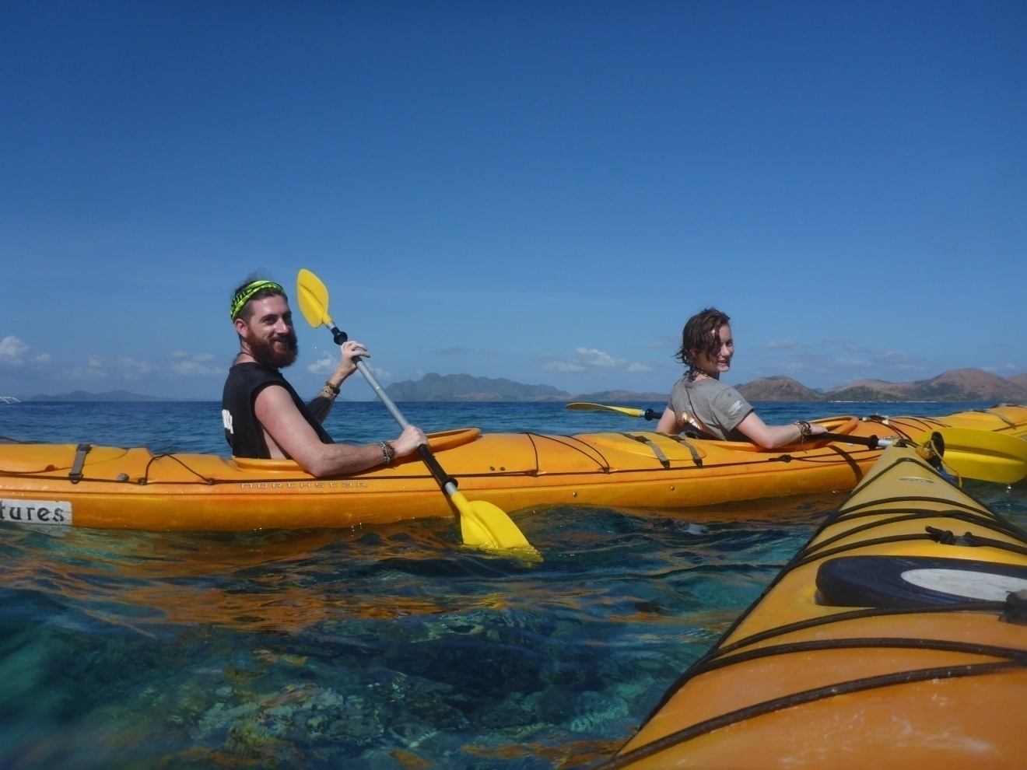
Couples are our most enduring market

Slide 8
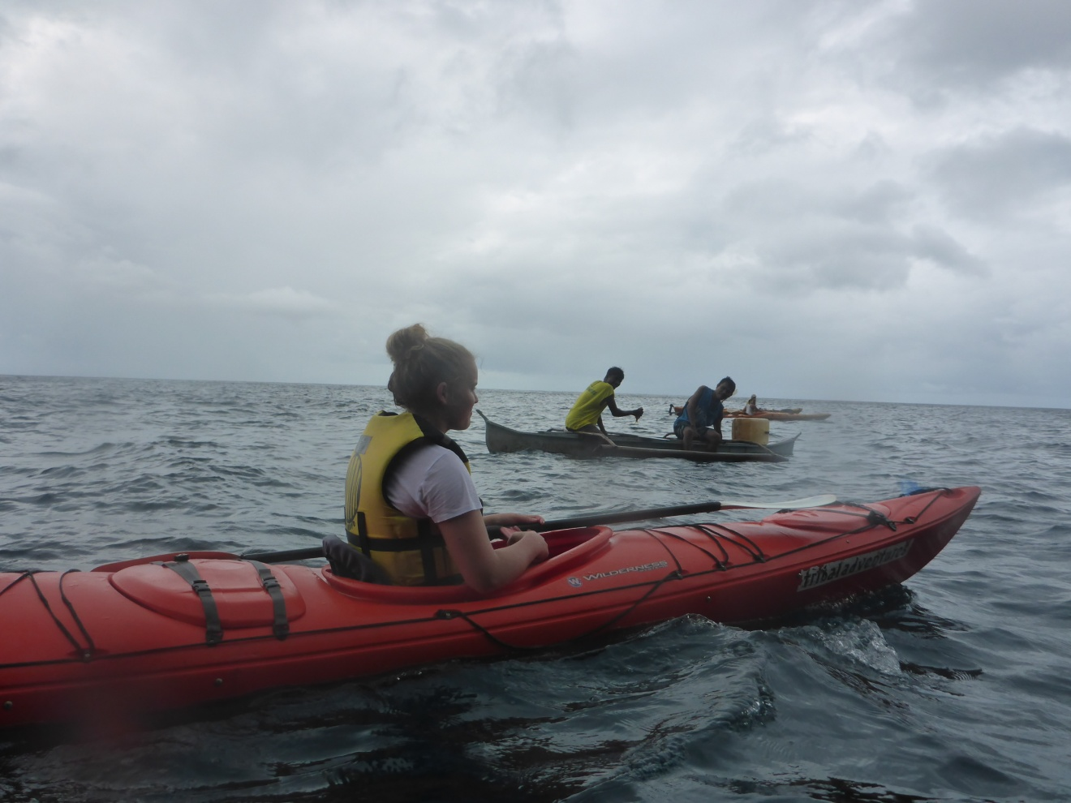
Paddling gets us closer to seascape & culture
Kayaking emulates Coron’s custodians, the Tagbanua, who paddle to fish, to get around their impenetrable island

Slide 9

To Coron’s Secret Lagoon: from Calis Point in the south or from Cabugao in the northeast
With wind light or from the west during April to November the tour heads anti-clockwise rounding Calis Point and heading north & northwest
Notes:
+++ The Remote Coron Kayak can start from the north or the south, depending upon the wind. From April to November, it’s likely to be from the south.
Map icon: Paddlers push off from camp or support boat near the lagoons and beaches of southwest Calis Point
Point out the deep undercuts through to Cathedral Cave
Then it’s the Green Lagoon, a couple of beaches on the way out, one of the which we’ll drop paddle at to swim, stroll
Then it’s more undercuts, arriving 45 minutes later to hammock beach for an extending break including lunch
It’s then 15 minute paddle into the Secret Lagoon

Slide 10
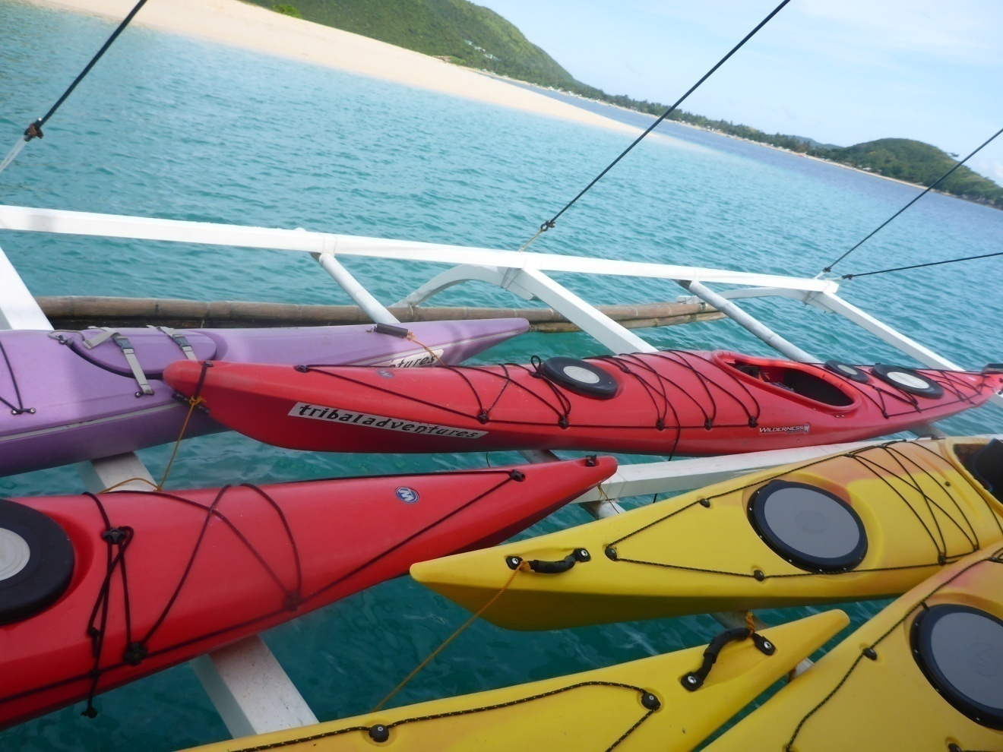
Access to launch point by large outrigger banca
Native boat so convenient for kayak support, carries the provisions and camping gear—and, with the participants, the full team: 3-person boat crew, camp manager, cook, guide, tour leader, sports therapist
Notes:
If the camp’s beyond a comfortable paddle away the start of the Remote Coron Kayak will likely be from the support boat

Slide 11
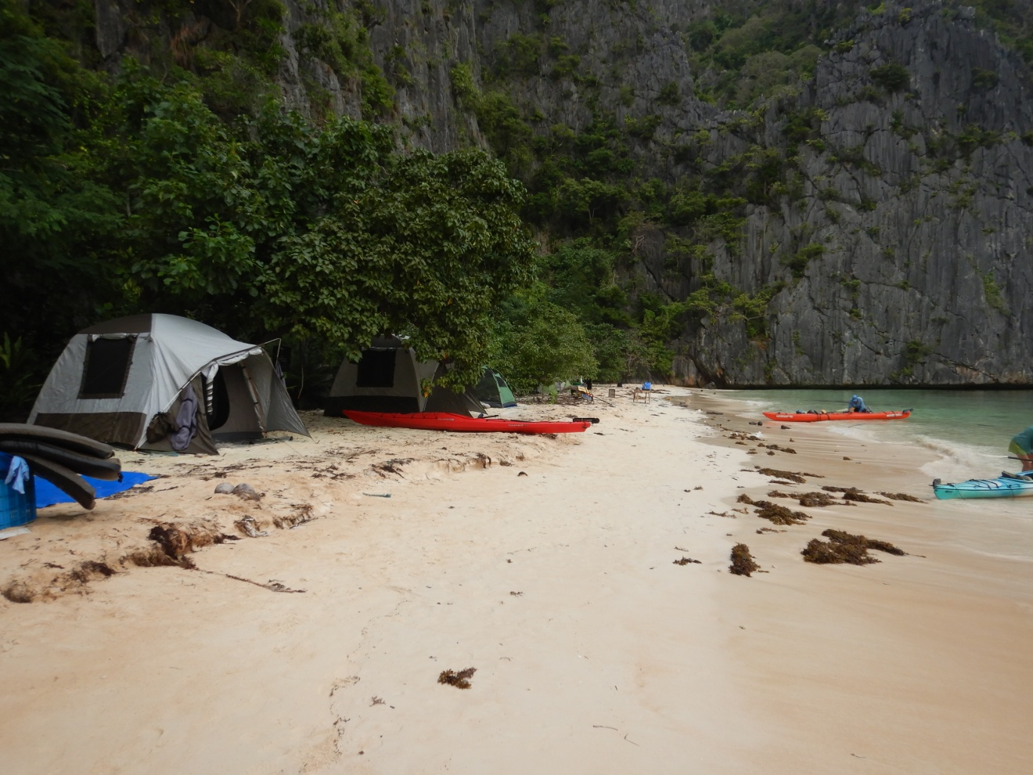
Overnight camp on the eve of the Remote Coron Kayak
Around the campfire stories are told of Noise & Punishment, how a politician caned whips the physical environment in to shape, and how boisterous children are not spared the rod for cultural desecration
Notes:
Briefed the evening before the Remote Coron Kayak, participants paddle from boat, local guide in front, the trip leader & story teller roving between kayakers

Slide 12
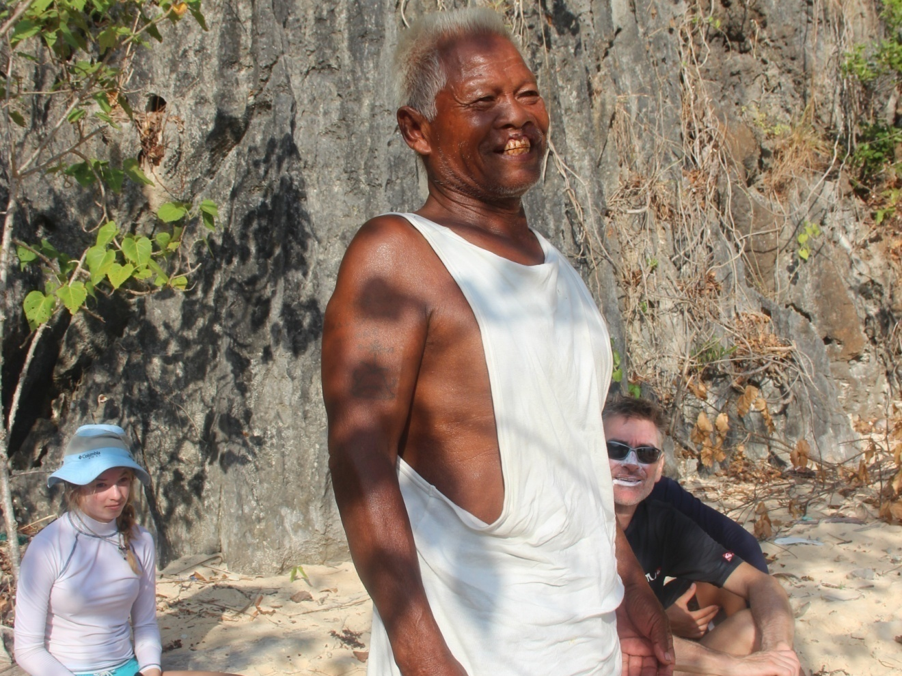
This Elder, Willie, proudly waxes lyrical about punishment, stunning the children
Whether the local politician Aguilar got whipped 10 or 30 times, or the talk of children getting the same treatment is just that – talk – the fact is there’s hardly a tree out of place, proving that from folklore law emerges
Notes:
On the water, whether speaking to participants in single or double kayaks or as a group, there’s elements of the story of Coron left unsaid: Aguilar—and the children—were given a free choice to be punished or not. A cheeky Australian kid when he learned of the choice commented to Willie that no self-respecting kid would voluntarily accept to be punished. Willie barked back—”Most did”. It’s not about self, but community. Respect and being respected.
Icon: Write LORE = LAW

Slide 13
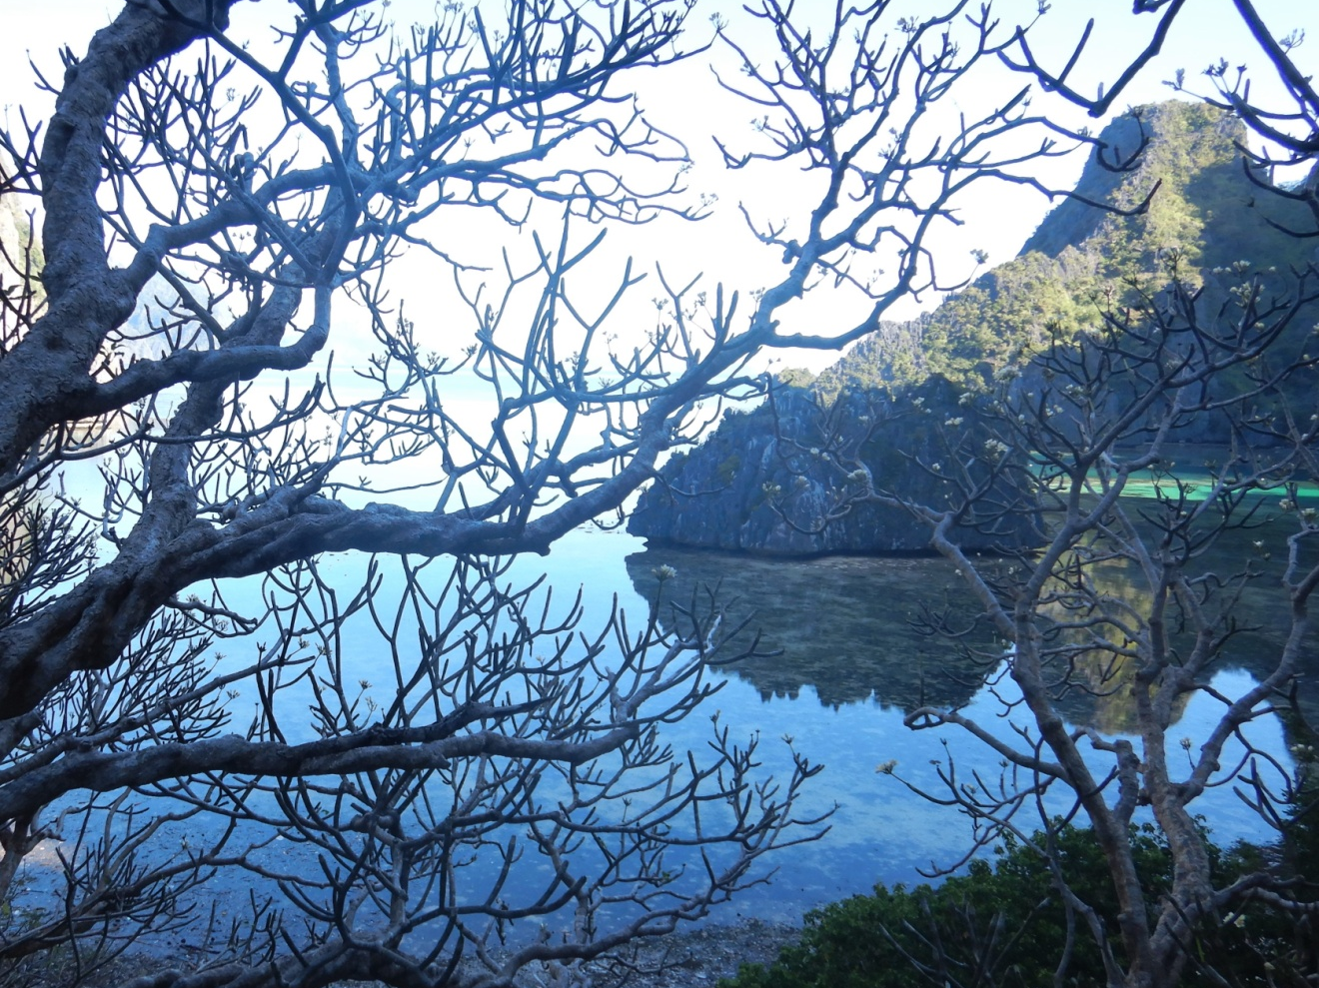
Main Message
Dwarfed by towering cliffs. Hypnotized by pulsating waves. Spellbound by a sacred lagoon. Awed by the island’s custodians

Slide 14
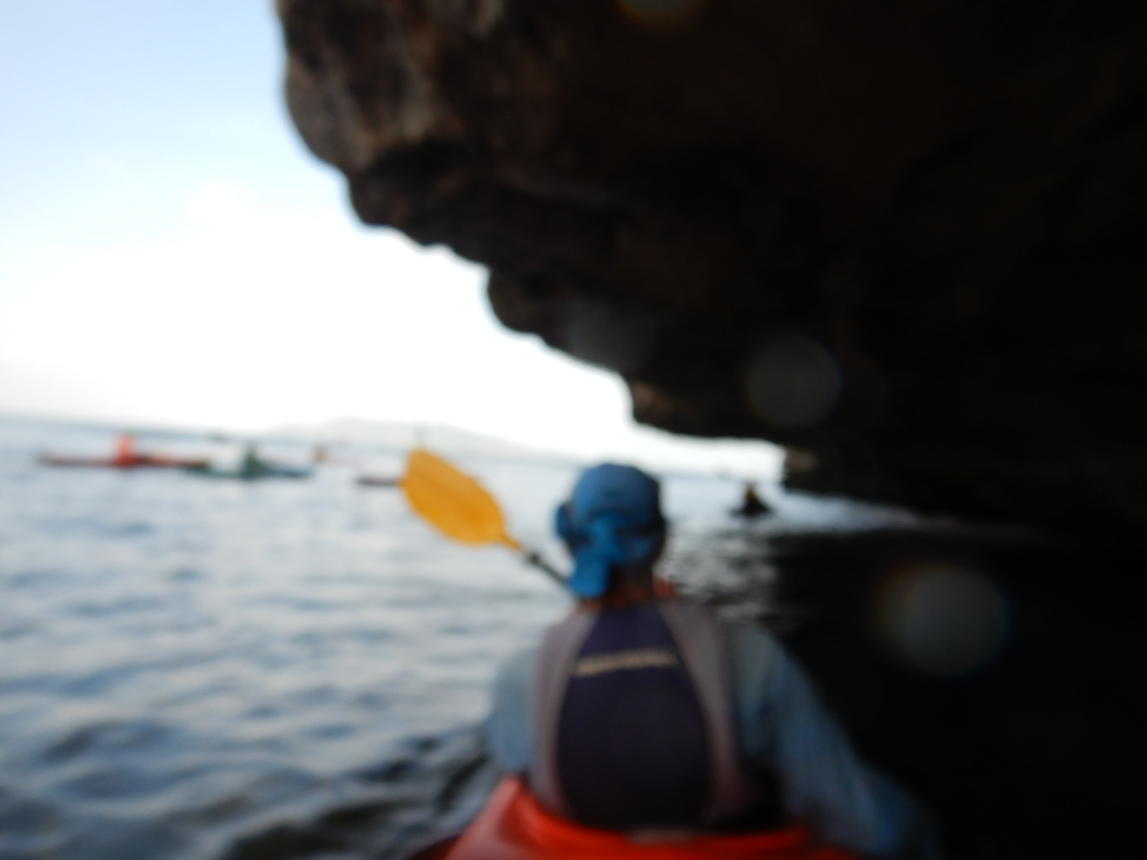
First Minor Message
Bob Dylan: “Time is an ocean but it ends at the shore”. Except in Coron’s undercut cliffs when it flies like “a jet plane, it moves too fast”.

Slide 15
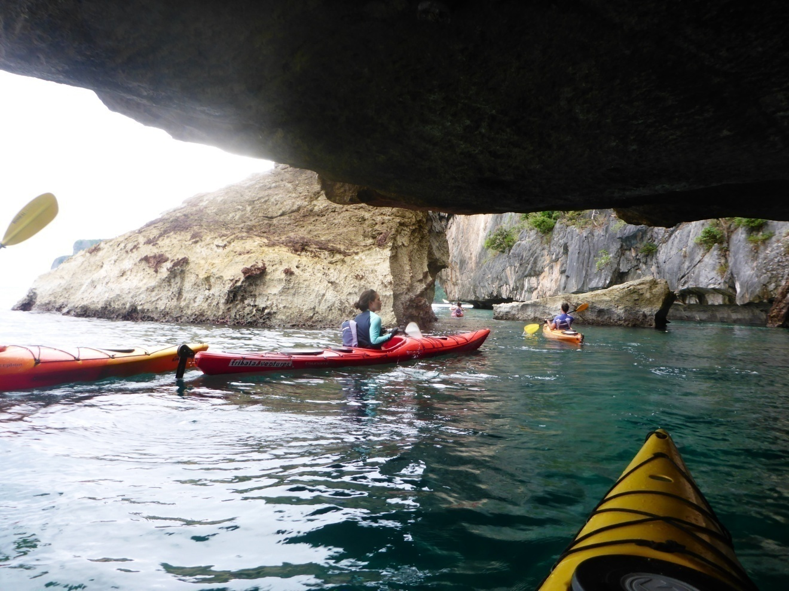
Second Minor Message
From time-tunnel to tranquil waters: gliding to kayaking nirvana one paddle stroke at a time

Slide 16
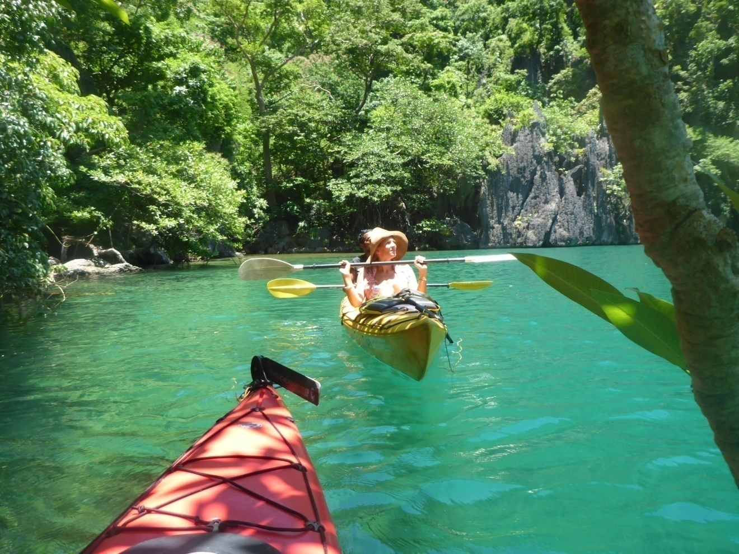
Third Minor Message: Learn the lingo of the lagoon if you want to chat
Listen to the Silence: The tribe has spoken

Slide 17
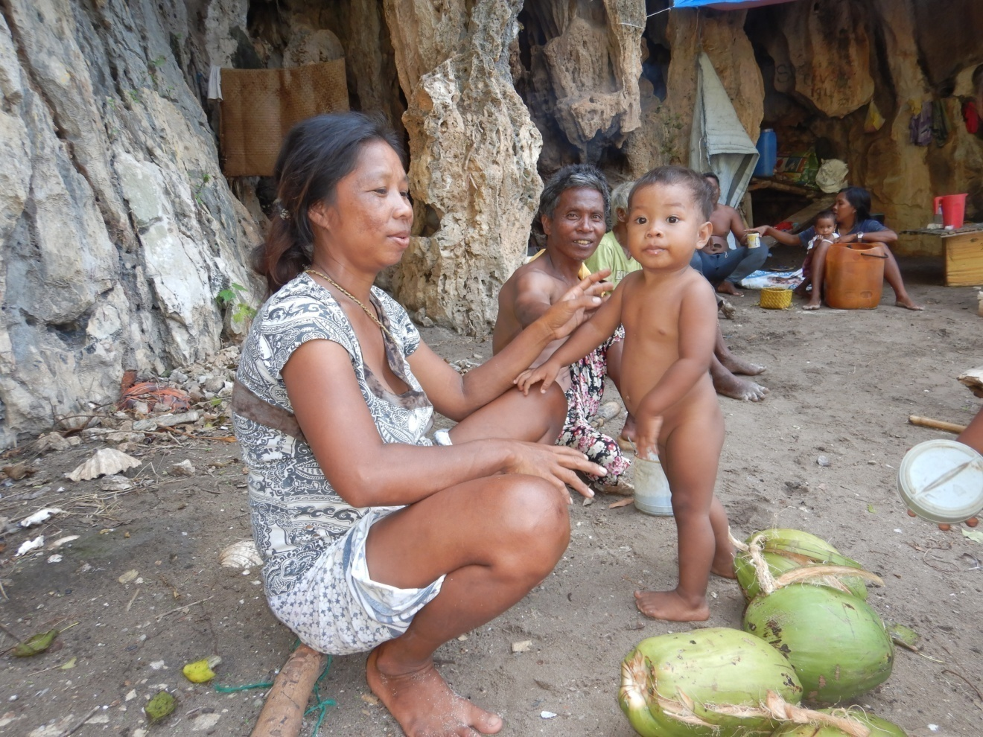
A cave on the foreshore is clan central for these Tagbanua
The remote south & east of Coron is where tourists aren’t and traditional culture is. It’s home to the Giant Octopus.
Notes:
The remote south & east is tribal, native. It’s rare to come across tourists. They stick to the far more accessible Northwest

Slide 18
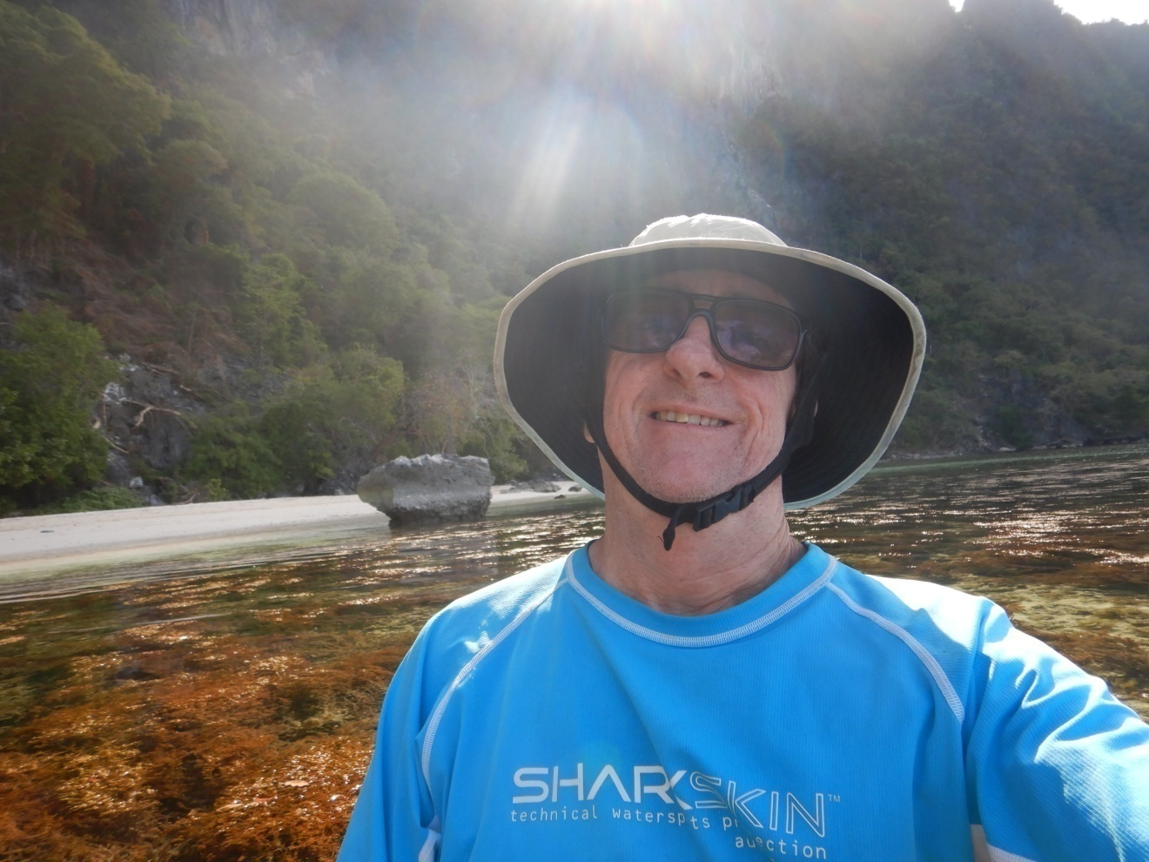
From the kayak, snippets are revealed one-on-one as leader roves among paddlers, local guide up front
Meet roving story teller, author, former foreign correspondent and kayaking enthusiast Greg Hutchinson
Notes:
There’s a plethora of prompts from frangipani to makeshift styrofoam kayaks to birds – triggers that segue to discussion of burial practices, catching octopus, and the Wallace Line theory of animal species distribution in Southeast Asia

Slide 19
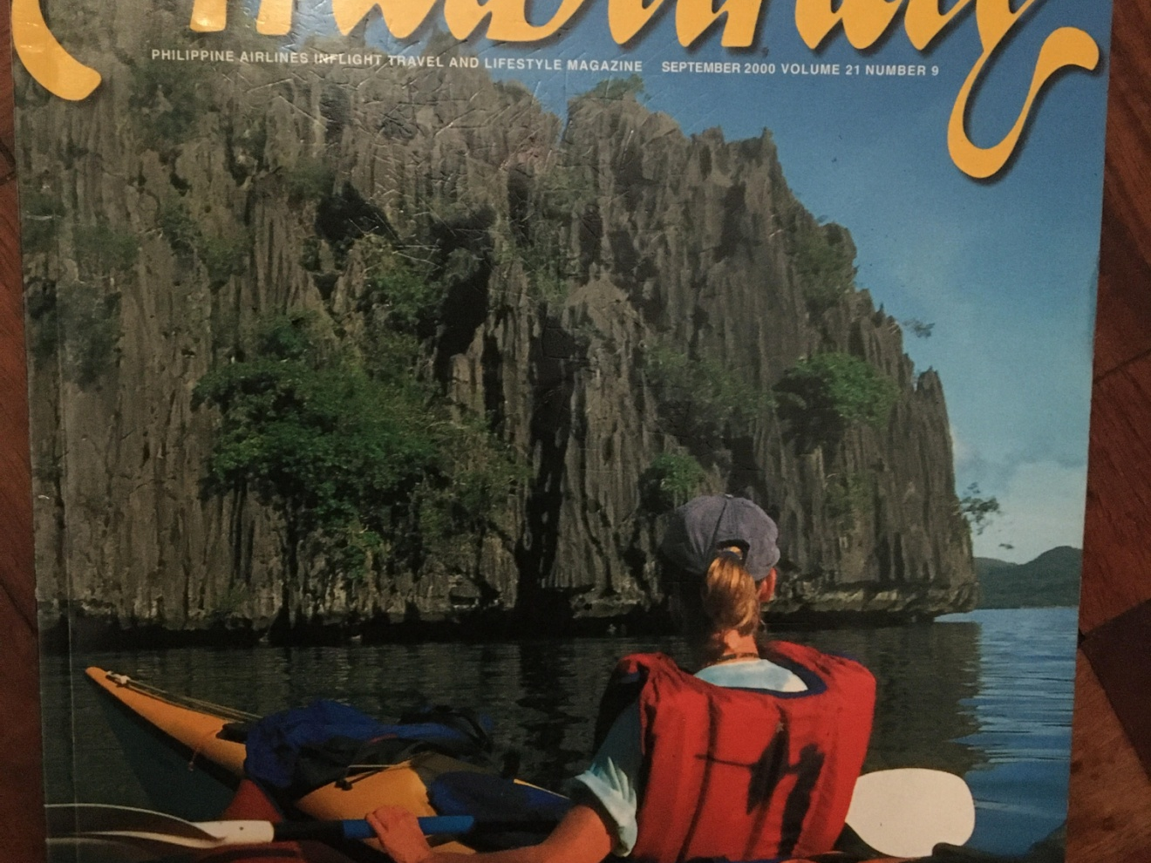
The main narrative of Noise & Punishment, Birds Nest Caves & Super human feats are kept for the group
Making a raft of kayaks, perhaps sharing a snack, discussion proceeds
Notes:
In 2000 I revealed the strength of Tagbanua culture in an article I’d like to believe, going forward, tied land and sea rights to tourism positively. Within 2 years the people won ancestral domain and plans evaporated to develop Coron Island for resorts.

Slide 20

Winning ancestral domain’s been a huge advance
Achieved quickly, thwarting dispossession, cultural and environmental degradation. Getting the word out fast & accurately fixes the narrative, avoids history’s rewriting
Notes:
That motivated me in writing in just six weeks my 2/3rds of a book I wrote. To avoid the political class burying the full narrative

Slide 21
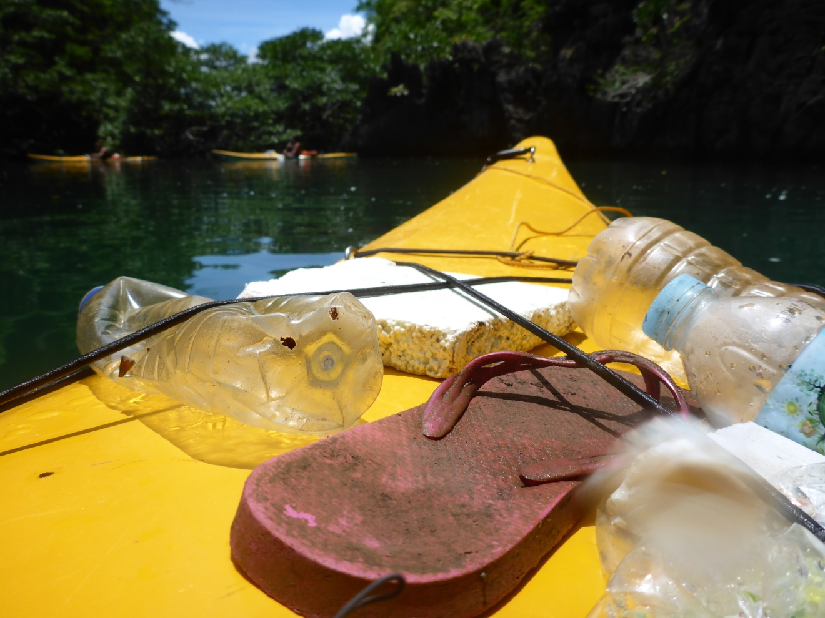
People power 15 years apart finished two corrupt presidents, and inspired people globally to act
The Tagbanua were empowered, their sea and land rights a world first, ensuring Coron’s sustainability
Notes:
The Remote Coron Kayak is predicated on beating the drum for indigenous rights and conservation. Having left the banca we round Calis Point, dwarfed by its towering limestone cliffs. The tide is receding. We answer the call of the cave-like undercuts.

Slide 22
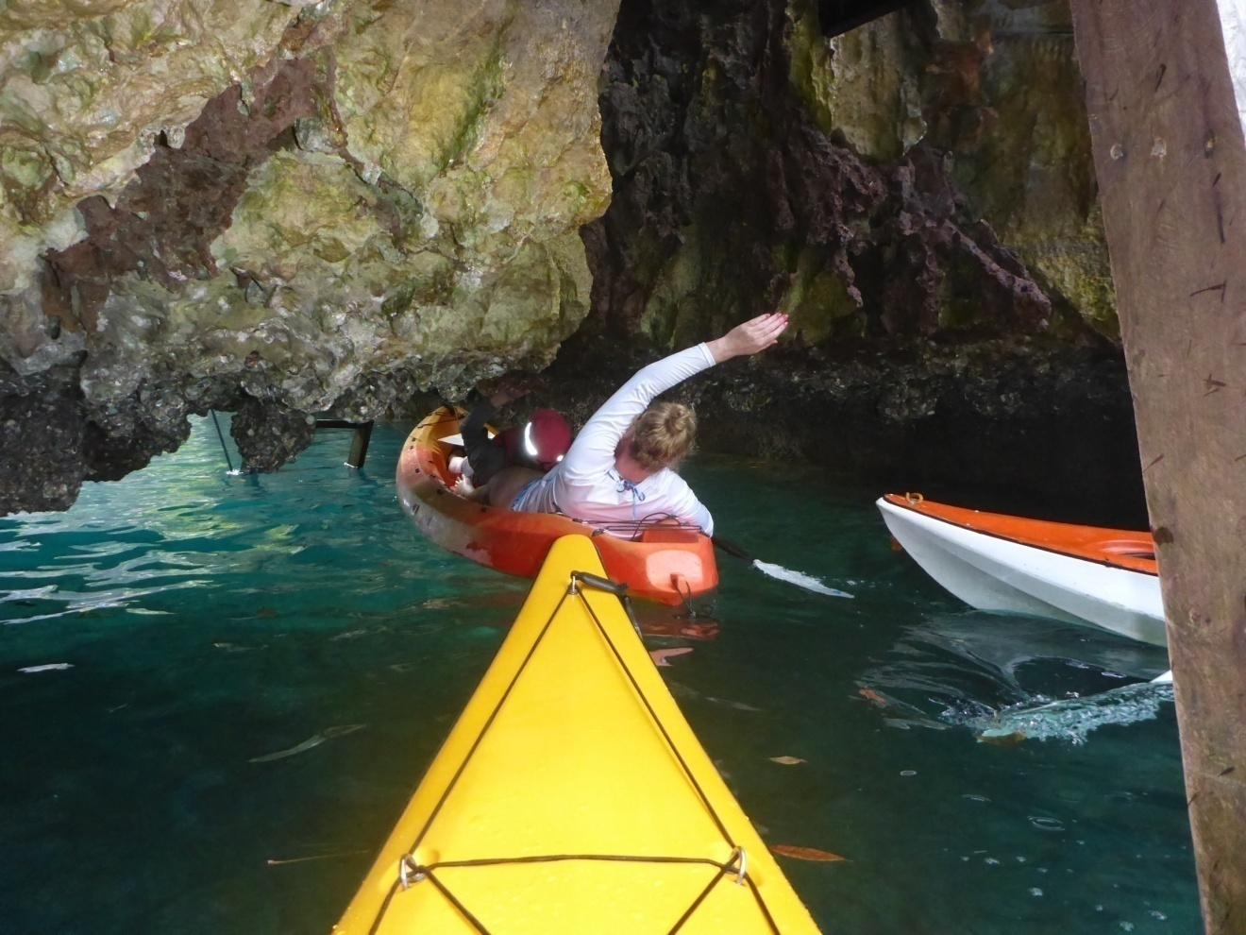
Enter the time-tunnel
Caves disorient, do funny things to the mind, making time slip by. Time does fly in the undercuts but a paddler’s orientation is if anything accentuated by the sun’s spotlight of the scene projected beyond the shadowed undercut

Slide 23
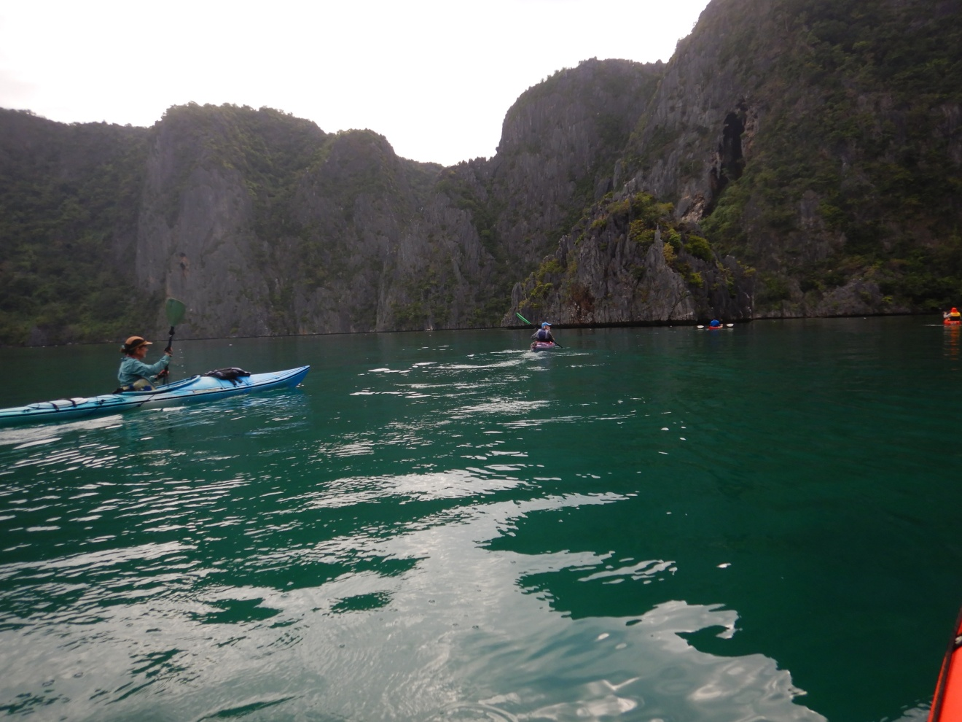
Bird nest caves above, cultivated seaweed below
Birds nest are worth their weight in gold—literally
Seaweed are of two kinds: commercial carrageenan and salad seaweed
All up, a Tagbanua family is looking at earning 500,000 pesos a year
Notes:
But there’s hardly riskier work—clambering up razor-sharp limestone cliffs for bird saliva, on occasions assisted by a rickety piece of bamboo.
Perhaps it’s little realised Carrageenan has made a Filipino with a yacht a billionaire, his riches coming from securing supply deals with seaweed farmers throughout the Philippine islands. And what is carrageenan most used for? The Big Mac
The salad at today’s lunch will be seaweed, the edible variety, it’s texture like sago. Prepared with coconut vinegar

Slide 24
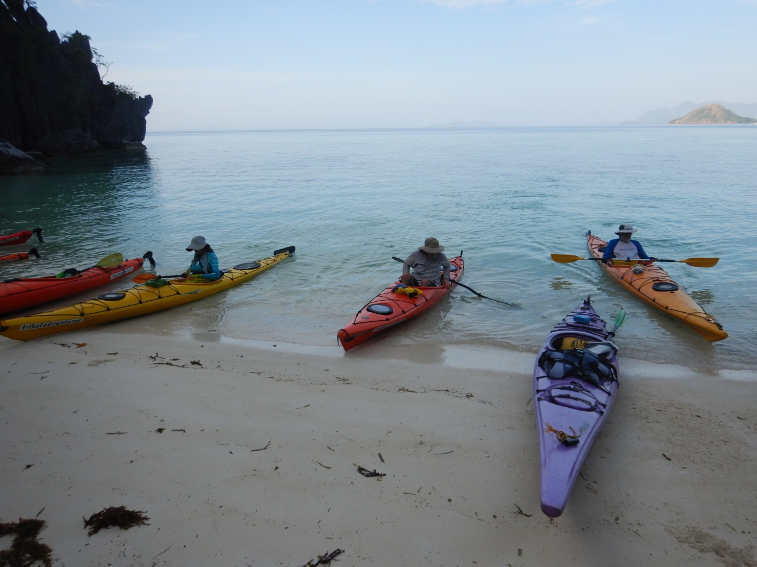
Beach break. Wonder the beach. Wander what’s over the forested vertical ridge rising 200 metres above
The what is nipa palm and bamboo. For the how you look down at the stone-hard calloused feet of Willie, now in his 70s, and still climbing cliffs barefoot
Notes:
That is when he’s not punishing children for being noisy!

Slide 25
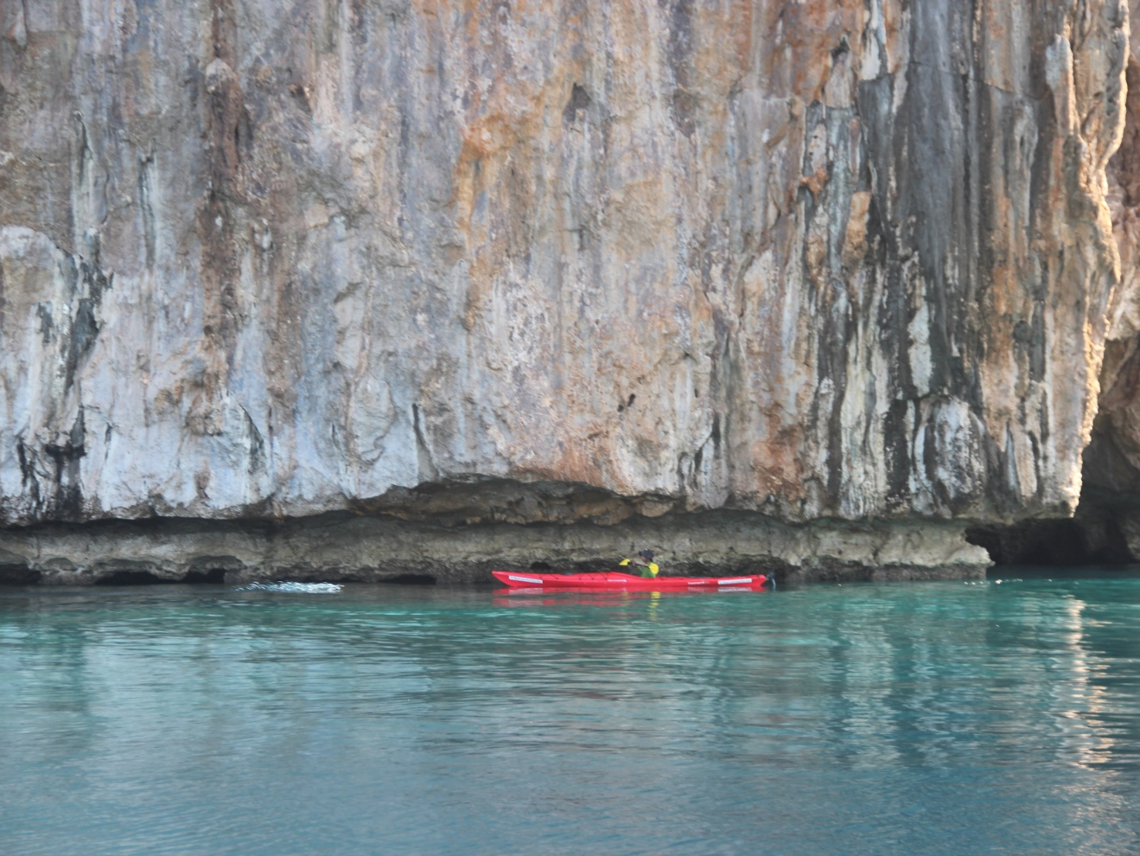
Sea pulsates beneath the overhangs
Time passages shared with swiftlets and bats, cormorants and the occasional sea eagle
Notes:
It’s no coincidence the sea’s been used as a metaphor for time by TS Elliot, Australia’s Kenneth Slessor and Nobel Laureatte Bob Dylan, and that coupled with how time seems to fly in a cave, that the undercuts paddled for 10 kms puts the paddler in a very different place
People lost in caves have slept for 30 hours at a single stretch. Even a most experienced British caver was disoriented in the Thai Cave rescue drama and he and one of the children in the soccer team had to be “reoriented” by Australian diver and anaesthetist Dr Richard Harris.

Slide 26
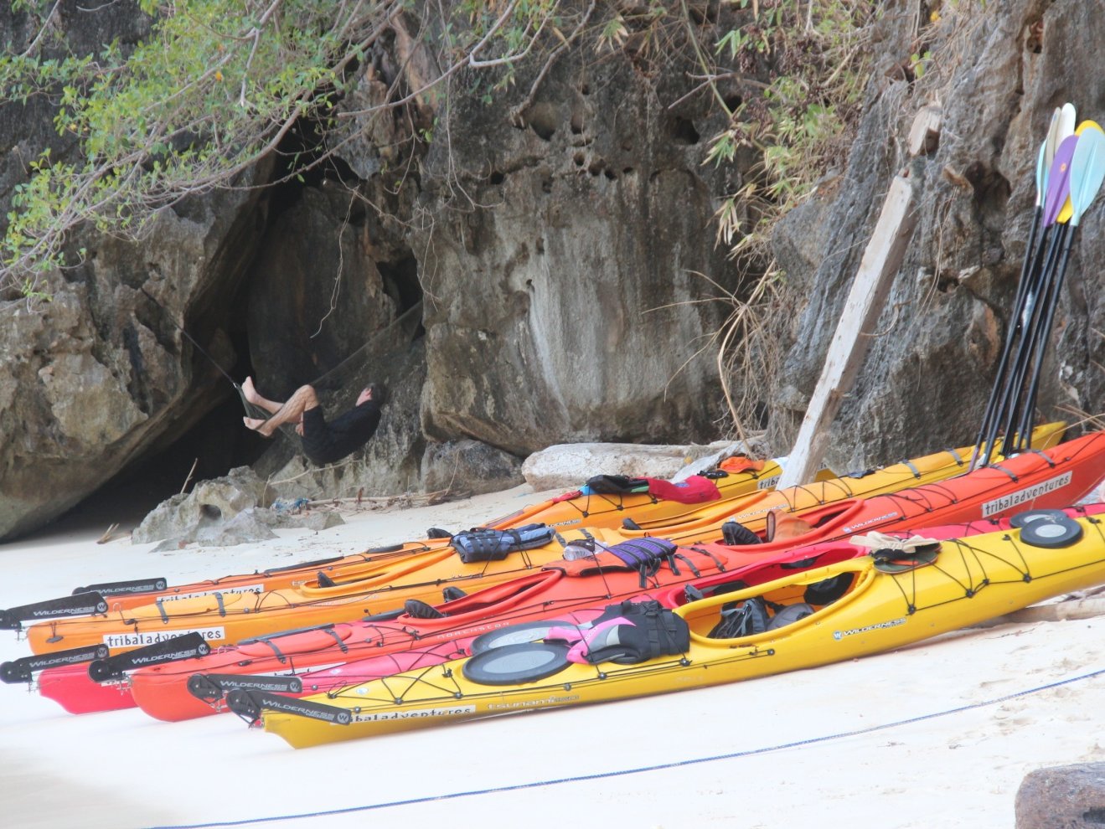
Transition & Reflection
Rest for the wicked ahead of lunch. Yes, that’s the story teller slumbering in his duyan (string hammock)

Slide 27
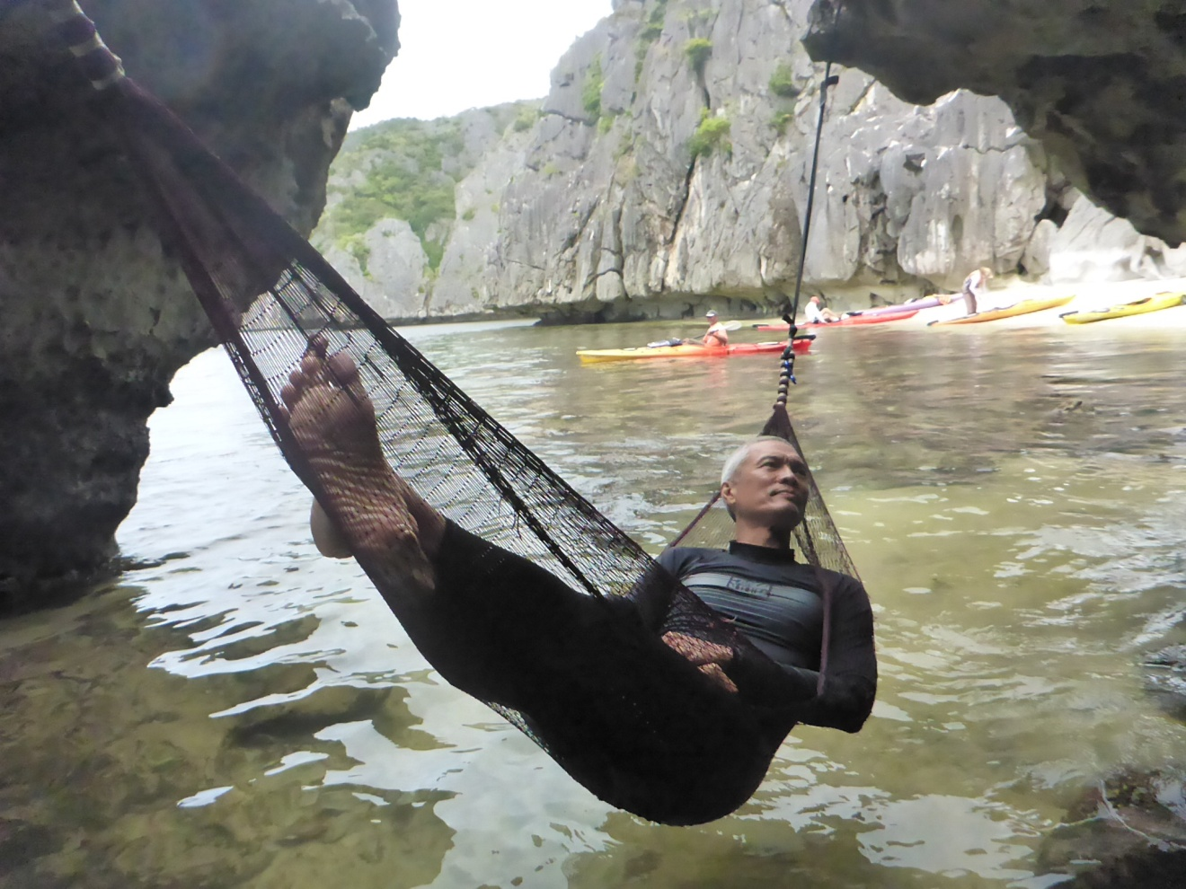
Tidal Alarm
When you don’t want to miss lunch
Notes:
+++ Some will get awakened by the rising tide

Slide 28
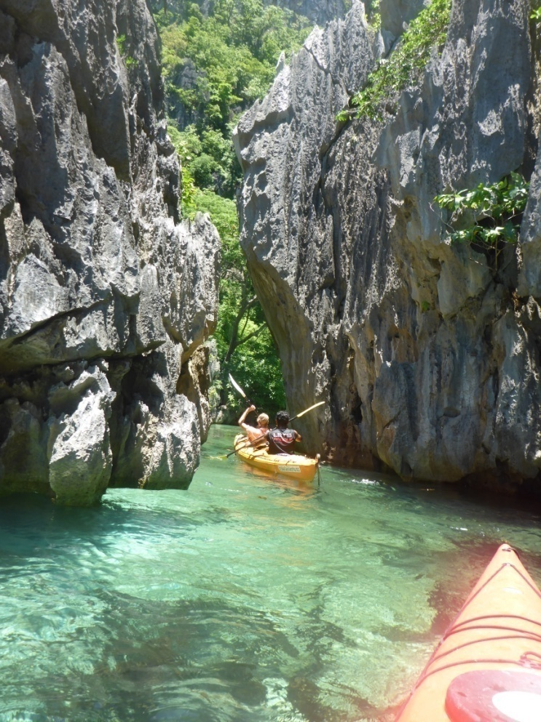
A slit in the limestone heralds a silent world
That’s after leaving hammock beach and weaving through a rock garden of limestone islets and rounding a point and two tiny coves, a paddle of 15 minutes or so.

Slide 29
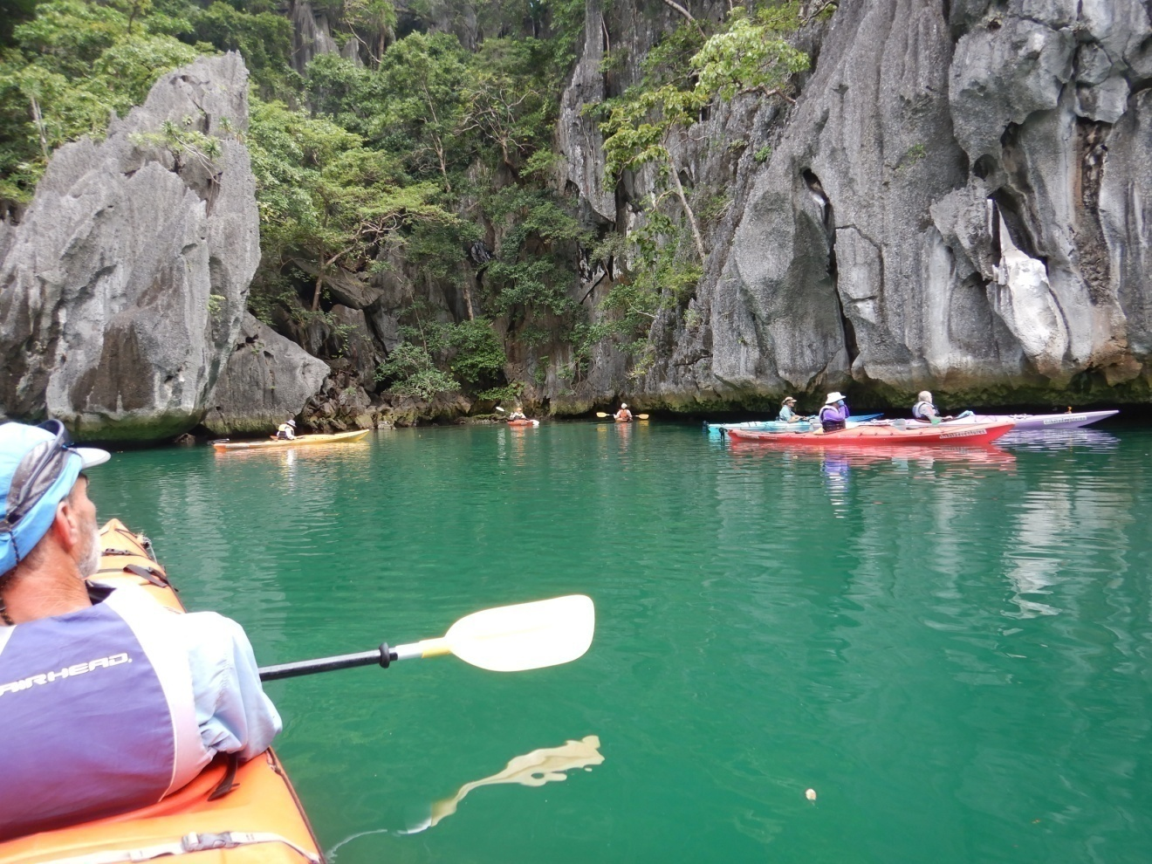
Listen to the Silence: The tribe has spoken
Except if you know the language of the lagoon

Slide 30
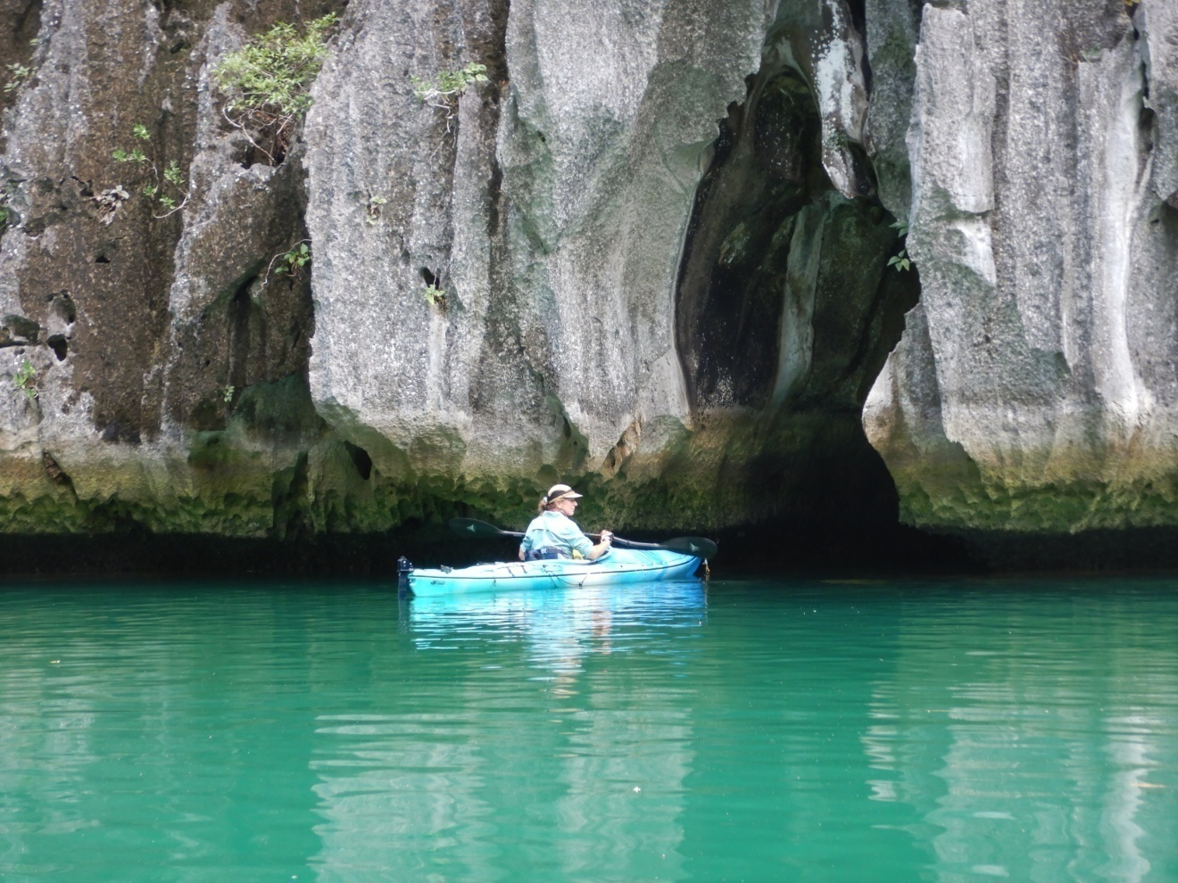
Rare slipper orchids on the limestone walls
And there are caves. And a lake inside the walls

Slide 31
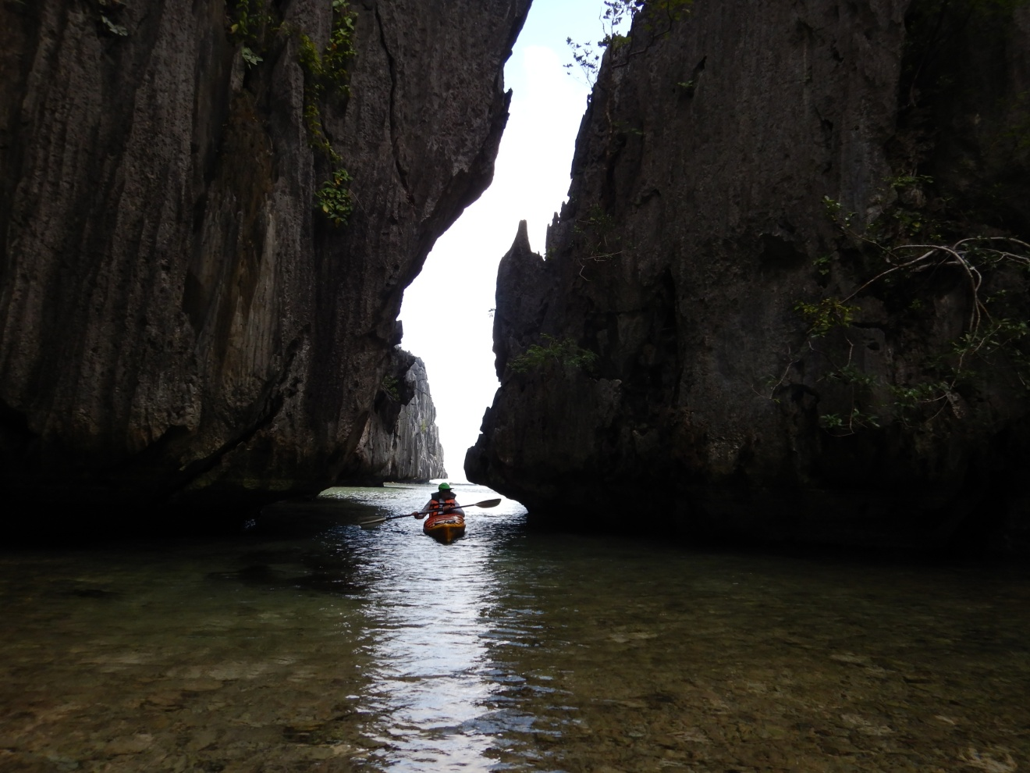
Exiting the Secret Lagoon: How instructive the Silence!
Enlightenment perhaps. Nothingness never

Slide 32
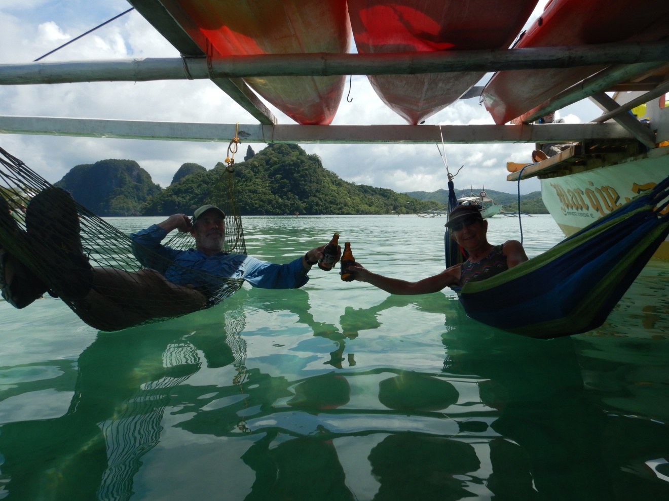
Cheers to the Tagbanua for the added value their ownership of Coron makes to the destination
Might we spare a thought to what the added value of a destination owned and controlled by its indigenous custodians brings to all of us—and what we as visitors can do, or refraining from doing, to further the empowerment of local people where ever we go on this wondrous planet!

Slide 33
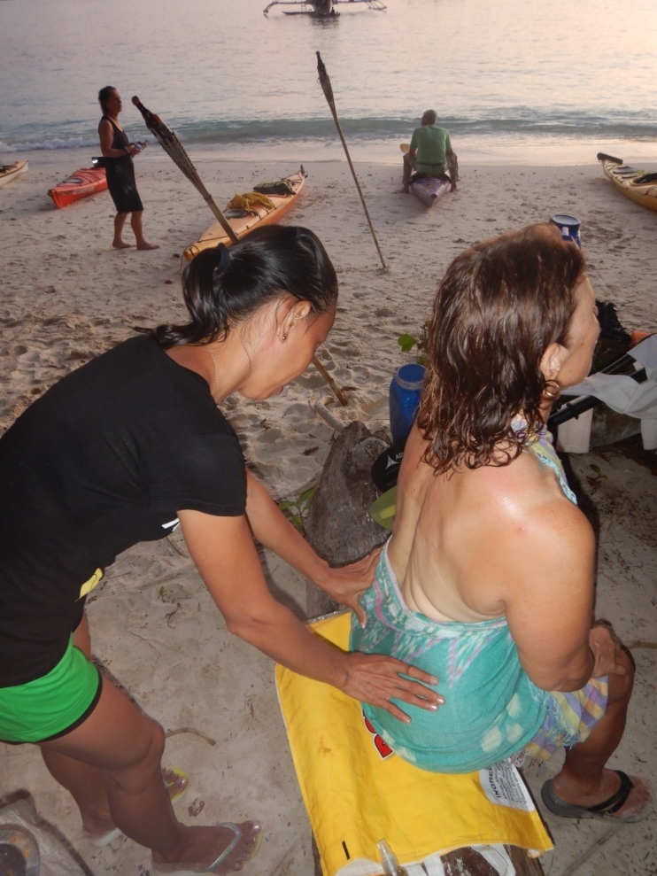
Covering 15 kms in a day is a workout for most of us
Sports massage makes muscles and joints more supple, better preparing paddlers to do the distance. It’s an example of why Tribal Adventures is the award-winning tour company it is. It paddles the extra mile!
Notes:
Feedback form on the presentation of Remote Coron Kayak
Greg Hutchinson
Proposition: Knowledge of Tagbanua traditions, practices and beliefs enriches the physical experience of kayaking east Coron
Not effectively conveyed Very effectively conveyed
1 2 3 4 5
Proposition: Kayaking undercut cliffs is akin to caving and losing a sense time
Not effectively conveyed Very effectively conveyed
1 2 3 4 5
Does the presentation compel you to be silent in the Secret Lagoon?
Not effectively Very effectively
1 2 3 4 5

Slide 34
Feedback Form
Proposition: Knowledge of Tagbanua traditions, practices and beliefs enriches the physical experience of kayaking east Coron
Not effectively conveyed Very effectively conveyed
1 2 3 4 5
Proposition: Kayaking undercut cliffs is akin to caving and losing a sense time
Not effectively conveyed Very effectively conveyed
1 2 3 4 5
Does the presentation compel you to be silent in the Secret Lagoon?
Not effectively conveyed Very effectively conveyed
1 2 3 4 5

Slide 35
From the presentation do you feel confident to participate in the guided east Coron kayak activity?
Yes Unsure No
If so, what’s your main motivation?
If not, what prevents you?
Of the following age groups, which is the group that the presentation is least pitched at?
12-17 18-29 30-49 50+
Why?
You’ve learned that Tagbanua say they punish noisy children; Do you believe there’s no place for talk of such a practice?
Agree Not sure Disagree
Kindly state why you answered the way you did.
Notes:
Irrespective of your position on matters of punishment, does the presentation move you to rethink tourism in favour of empowering indigenous people?
No Not sure Yes

Slide 36
Irrespective of your position on matters of punishment, does the presentation move you to rethink tourism in favour of empowering indigenous people?
No Not sure Yes
Which people in your experience or sphere are least empowered to control tourism in their area?
Does the presentation make you more likely to act to correct the injustice of disempowerment?
No Not sure Yes
What would you do if you could?

